Slide 1

Module 3.8
Application Testing

Slide 2
Application testing
Notes:
This page intentionally blank

Slide 3


Build
The drop down menu "Build" allows access to the software tools used to analyze and build a project
Analyze : Insures that the current section contains a valid program
  Programming errors such as, undefined symbols, unconnected elements etc.. will be displayed in the in the Output Window section of the screen
Analyze project : Scans the entire project for errors

Slide 4
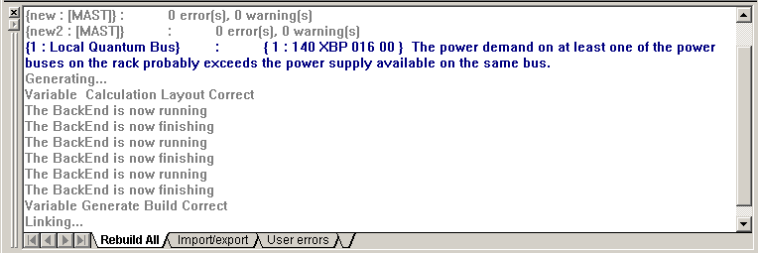
Build (cont.)
Build Project
  Creates a file that can be downloaded to the PLC or the PLC Simulator
Rebuild all Project
  Takes into account the changes made to an existing project

Slide 5
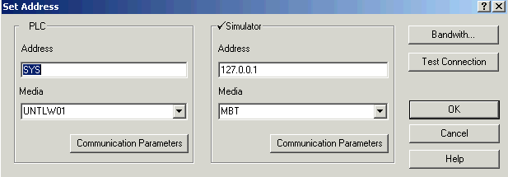
Connecting to the PLC
The first step in connecting to a PLC or the PLC Simulator is to define the address of the PLC
The "Communication Parameters" tab allows direct access to the Driver Manager using the "Driver Settings" icon

Slide 6
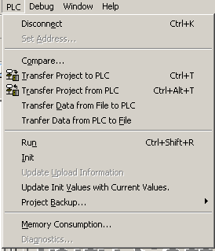
Connect Mode
In the Connect Mode (online)
  A comparison can be made between the project in the PC and the project in the PLC
  A project can be transferred to the PLC or from the PLC
  Data can be transferred to the PLC or from the PLC
  Project backup functions such as Backup Compare, Save, Restore, Clear can be selected
  The PLC can be put into Run or Stop mode or initialized
  The Memory Usage dialog screen can be launched

Slide 7
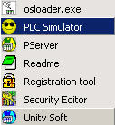

Unity Simulator
The Unity Simulator can be used to:
  Simulate the operation of a Quantum or Premium PLC
  Search for or record errors in the user program
Starting the PLC Simulator
  Launch the simulator from the Start menu (Programs-> Schneider Electric-> Unity Soft-> PLC Simulator)
  launch the simulator from the desktop shortcut
  Note: the simulator can be started with the Unity Pro software running

Slide 8
Unity Simulator
Loading an application to the simulator
  From the menu bar of Unity Pro select PLC-> Connect
  "Drag & Drop" the application file to the simulator program icon if the simulator is not started
  "Drag & Drop" the application file to the open simulator control if the simulator is already started

Slide 9
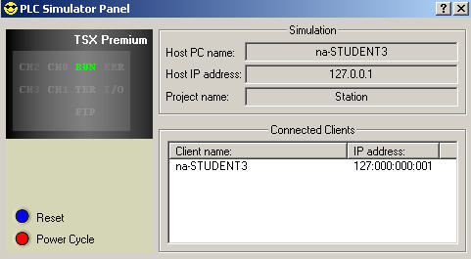
Simulator Control Panel
Right click on the Simulator icon in the System tray and select Simulator Panel to launch the Simulator Control Display.
  When a project is transferred to the simulator the display shows an image of the configured PLC. This image show
    The status of the PLC, for example, Run, Err, I/O (Error) etc..
    The name of the Host PC and it's IP address
    The name of the project being run in the simulator
    The name and IP address of the Clients that are connected

Slide 10
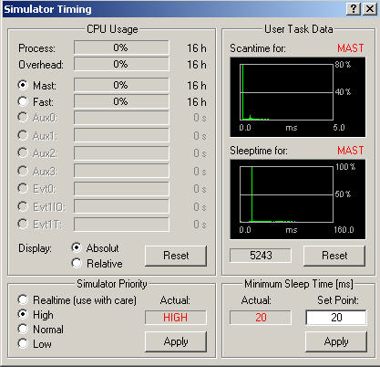
Simulator Timing
This dialog shows simulator statistics such as Scan Time of the task, Processor load and overhead as a percentage
  Simulator Priority and Minimum sleep time can be adjusted to optimize simulator timing
Note : for more information on these adjustments see the help screens or user manuals

